Slide 1

Dr. PRABHA SELVARAJ
AP SG1/SCOPE
VIT-AP UNIVERSITY.

Slide 2
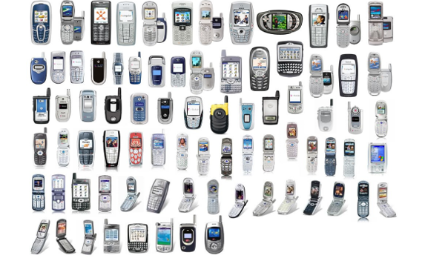

Slide 3
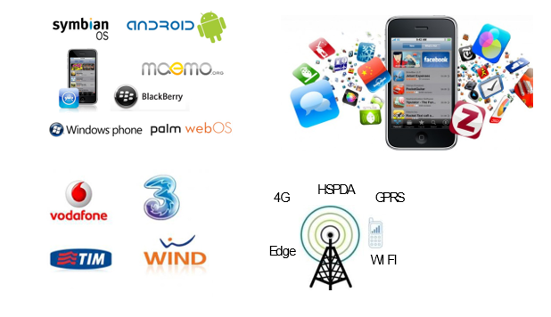

Slide 4
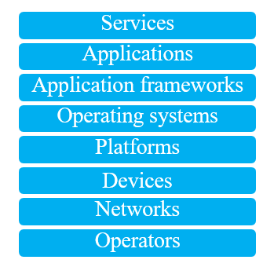

Slide 5
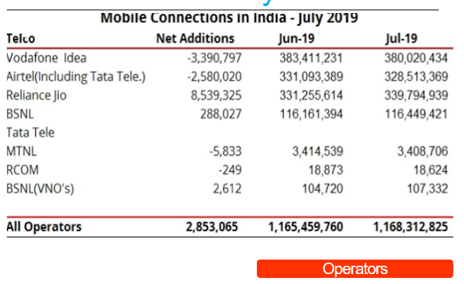

Slide 6
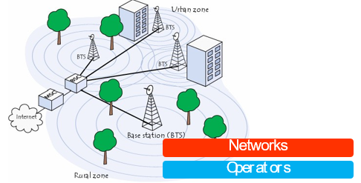
Mobile networks

Slide 7
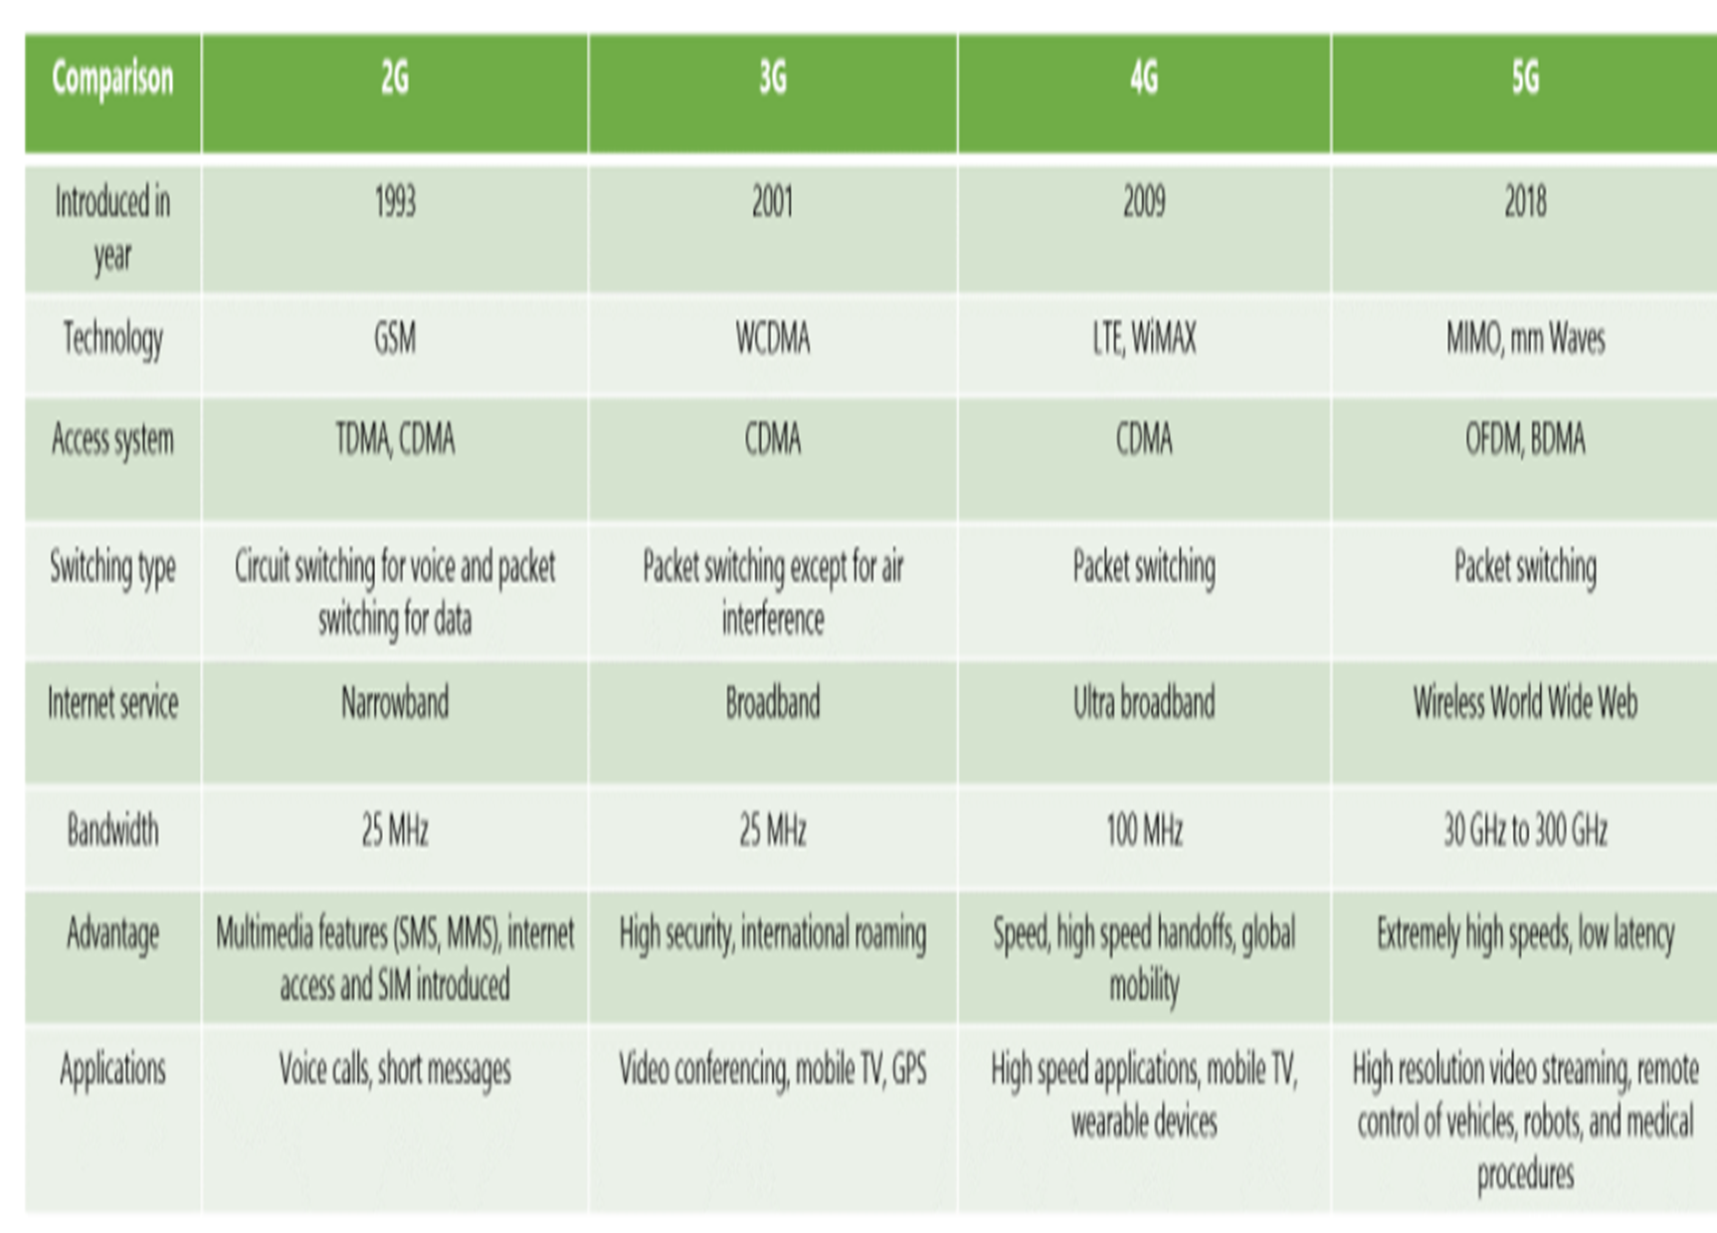

Slide 8
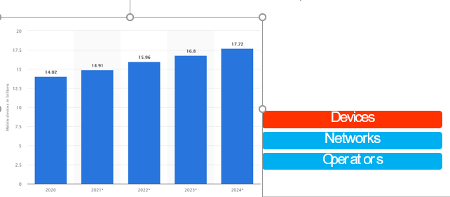

Slide 9
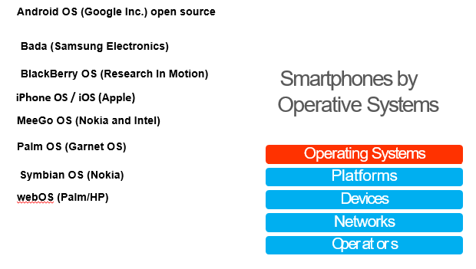
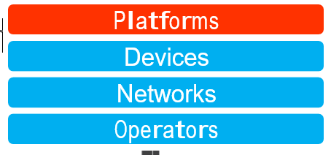
PLATFORMS
Open Source
Proprietary
Licensed

Slide 10
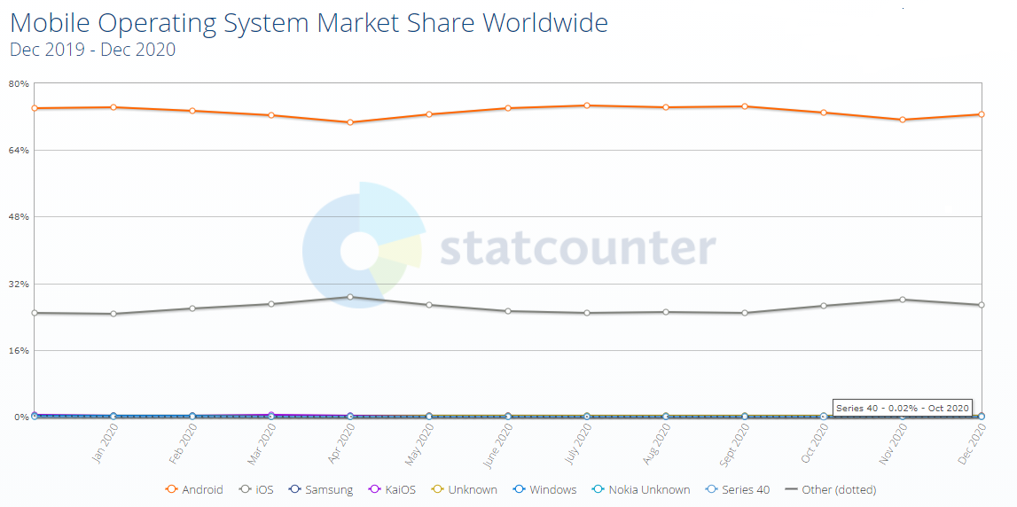

Slide 11
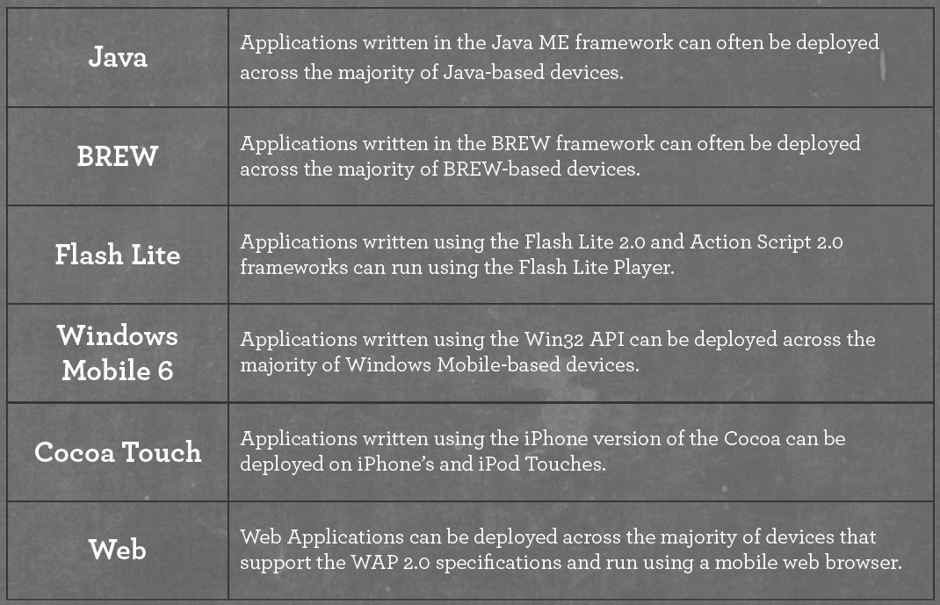
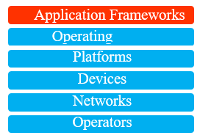
APPLICATION FRAMEWORK

Slide 12
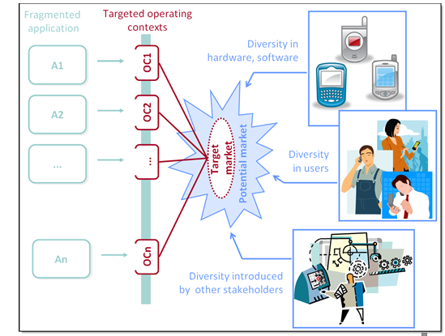
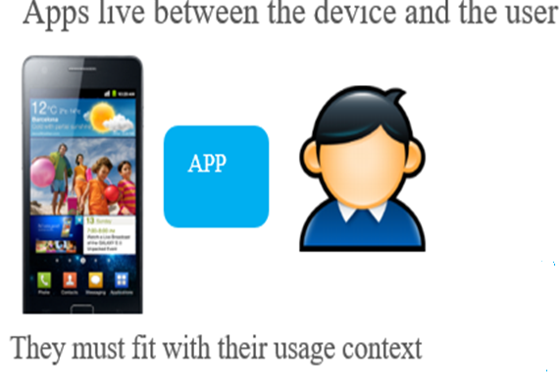
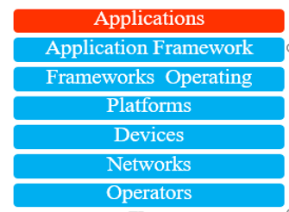

Slide 13
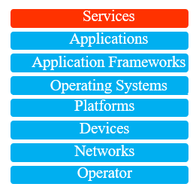
Services
“everything the user is trying to do”
They are often available at different levels:
Application
Application Framework
OS

Slide 14

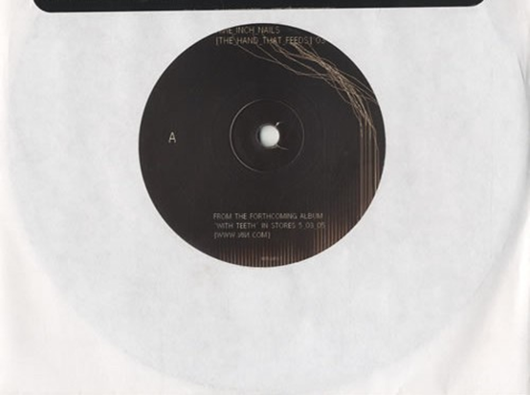
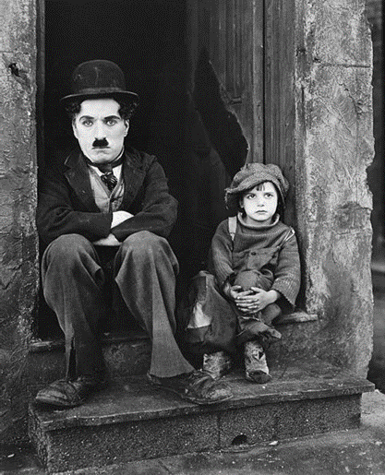
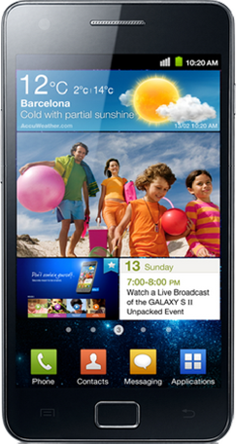
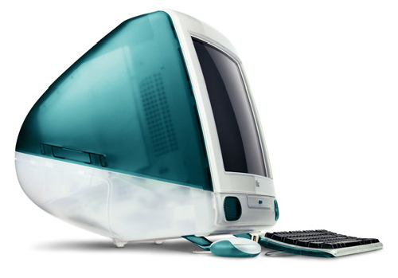
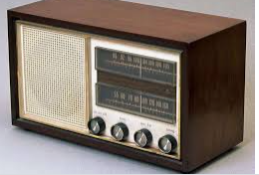

Mobile as the 7th mass media

Slide 15

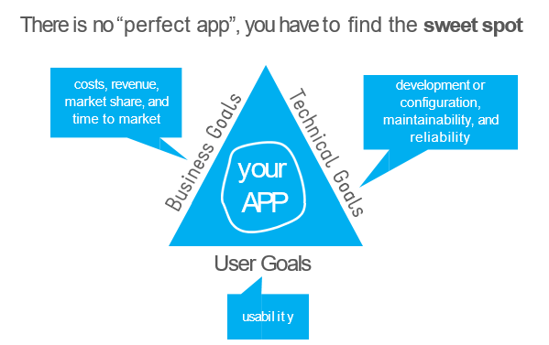

Slide 16
Tips for the project
This is check list when reviewing an app:
✓ Does it have a clear goal?
✓ Is it filling a real need?
✓ Does it consider the context in which I’m using it?
✓ Is it integrated with other services?
✓ Is it a pleasure to use it?
I look at UI design, interface slickness, etc

